Slide 1

Mechanistic Kinetic Modeling of Furfural Hydrodeoxygenation to Produce 2-Methylfuran in a Fixed Bed Reactor
- CP-303
Presented by:
Sayed Musaraf Ali
2022CHB1057
Guided by:
Dr. tarak mondal

Slide 2
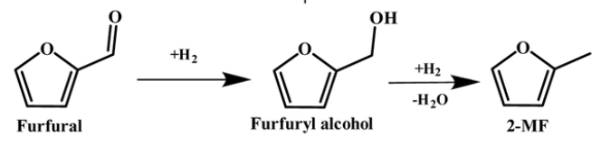
Introduction
MOTIVATION
Furfural is a key biomass-derived platform molecule obtained from lignocellulosic feedstocks.
Upgrading furfural to fuels enhances the value of renewable biomass resources.
Target product: 2-Methylfuran (2-MF)
High energy density biofuel
SIGNIFICANCE OF KINETIC STUDY
Helps identify rate controlling steps and adsorption effects
Provides mechanistic understanding beyond empirical correlations
Catalyst: CuFe₂O₄ (Copper Ferrite) + Cu/Fe2O3

Slide 3
Project Objectives
Establish an empirical power-law kinetic model.
Develop a mechanistic Langmuir–Hinshelwood–Hougen–Watson (LHHW) model.
Estimate kinetic & thermodynamic parameters.
Validate models statistically.
Compare empirical (power law) and mechanistic (LHHW) kinetic models
Propose detailed reaction mechanism based on elementary surface reactions

Slide 4
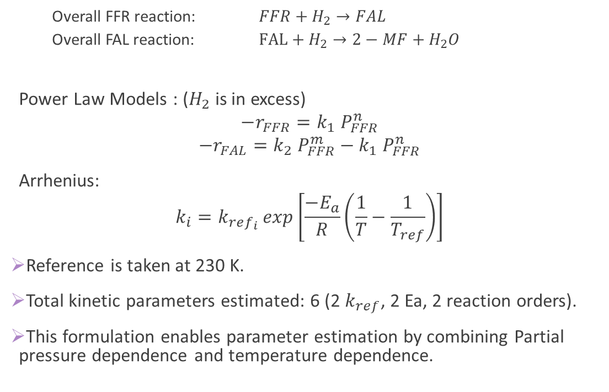
Kinetic Models Considered
Overall FFR reaction: $FFR+H_{2}→FAL$
Overall FAL reaction: $FAL+H_{2}→2−MF+H_{2}O$
Power Law Models : ($H_{2}$is in excess)
$$−r_{FFR}=k_{1} P_{FFR}^{n}$$
$$−r_{FAL}=k_{2} P_{FFR}^{m}−k_{1} P_{FFR}^{n}$$
Arrhenius:
$$k_{i}={k_{ref_{i}}}_{ }exp\left[\frac{−E_{a}}{R}\left(\frac{1}{T}−\frac{1}{T_{ref}}\right)\right]$$
Reference is taken at 230 K.
Total kinetic parameters estimated: 6 (2 $k_{ref}$, 2 Ea, 2 reaction orders).
This formulation enables parameter estimation by combining Partial pressure dependence and temperature dependence.

Slide 5
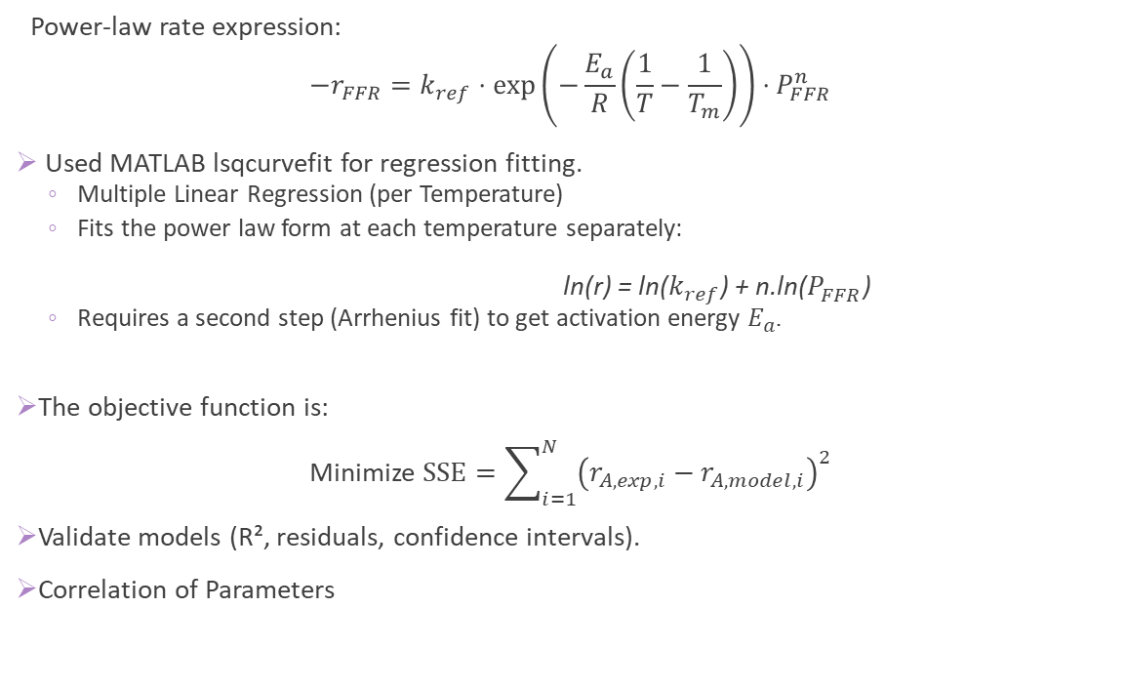
Estimation of Kinetic Model Parameters
Power-law rate expression:
$$−r_{FFR}=k_{ref}⋅\exp\left(−\frac{E_{a}}{R}\left(\frac{1}{T}−\frac{1}{T_{m}}\right)\right)⋅P_{FFR}^{n}$$
Used MATLAB lsqcurvefit for regression fitting.
Multiple Linear Regression (per Temperature)
Fits the power law form at each temperature separately:
ln(r​) = ln($k_{ref}$) + n.ln($P_{FFR}^{}$)
Requires a second step (Arrhenius fit) to get activation energy $E_{a}$.
The objective function is:
Minimize $\text{S}\text{S}E=\sum_{i=1}^{N}{{\left(r_{A,exp,i}−r_{A,model,i}\right)}^{2}}$
Validate models (R², residuals, confidence intervals).
Correlation of Parameters

Slide 6
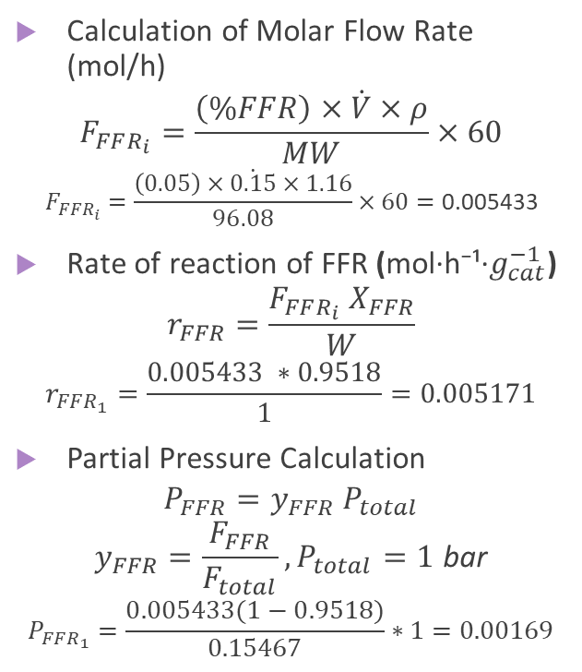
Data Processing
Raw experimental data provided:
Volumetric flow rate (mL/min)
Temperature (°C)
Conversion of Furfural (FFR)
Yield of Furfuryl Alcohol (FAL)
Yield of 2-Methylfuran (2-MF)
Catalyst weight (W)
5% FFR in IPA
Calculation of Molar Flow Rate (mol/h)
$$F_{FFR_{i}}=\frac{\left(\%FFR\right)×\dot{V}×ρ}{MW}×60$$
$$F_{FFR_{i}}=\frac{\left(0.05\right)×\dot{0.15}×1.16}{96.08}×60=\text{0}\text{.}\text{005433}$$
Rate of reaction of FFR (mol·h⁻¹·$g_{cat}^{−1}$)
$$r_{FFR}=\frac{F_{FFR_{i}} X_{FFR}}{W}$$
$$r_{FFR_{1}}=\frac{0.005433 ∗0.9518}{1}=0.005171$$
Partial Pressure Calculation
$$P_{FFR}=y_{FFR} P_{total}$$
$$y_{FFR}=\frac{F_{FFR}}{F_{total}}, P_{total}=1 \text{bar}$$
$$P_{FFR_{1}}=\frac{0.005433(1−0.9518)}{0.15467}∗1=0.00169$$

Slide 7
RESULTS
FFR to FAL
FAL to 2MF
Parameters | Value | -95% CI | +95% CI
k_ref (mol/h.g.bar^n) | 0.087094 | 0.08328 | 0.09091
Ea (KJ/mol) | 42.80 | 39.08 | 46.52
n (FFR order) | 0.364 | NR | NR
RMSE | 0.002304
Parameter | Value | -95% CI | +95% CI
k_ref (mol/h.g.bar^m) | 0.135041 | 0.09722 | 0.17286
Ea (KJ/mol) | 73.26 | 38.11 | 108.41
m (FAL order) | 0.533 | NR | NR
RMSE | 0.001437

Slide 8
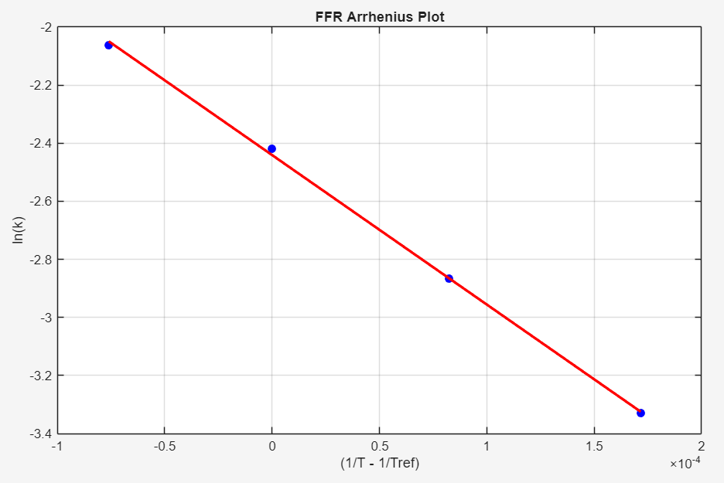
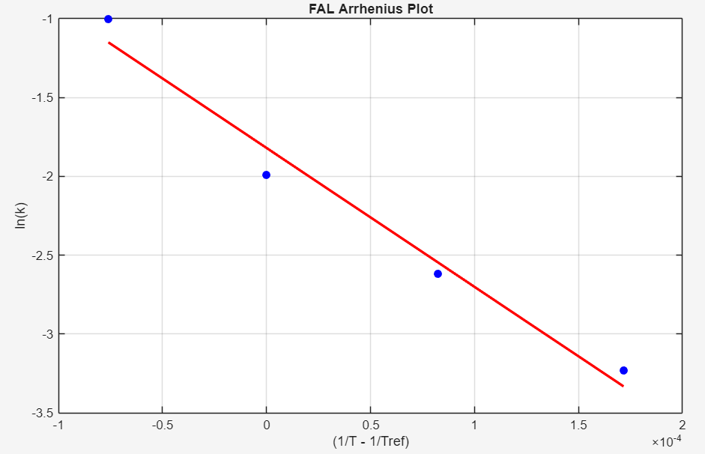


Arrhenius Analysis
Slope = -E/R = -5148.358055
Intercept = ${lnk}_{c_{ref}}$= -2.440768
Slope = -E/R = -8811.724
Intercept = ${lnk}_{e_{ref}}$= -1.819507

Slide 9
Correlation Matrix
FFR to FAL
FAL to 2-MF
Params | k_ref | Ea | n
k_ref | 1 | 0.0747 | 0.8824
Ea | 0.0747 | 1 | 0.5009
n | 0.8824 | 0.5009 | 1
Params | k_ref | Ea | m
k_ref2 | 1 | 0.1666 | 0.994
Ea | 0.1666 | 1 | 0.2557
m | 0.994 | 0.2557 | 1
Correlation | Interpretation
< 0.3 | Good
0.3–0.7 | Moderate
> 0.8 | Strong (problematic)

Slide 10
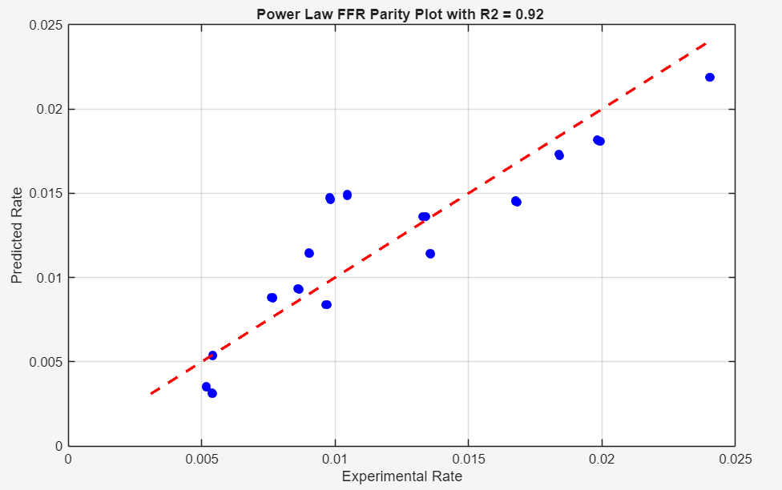
Parity Plot -FFR to FAL

Slide 11
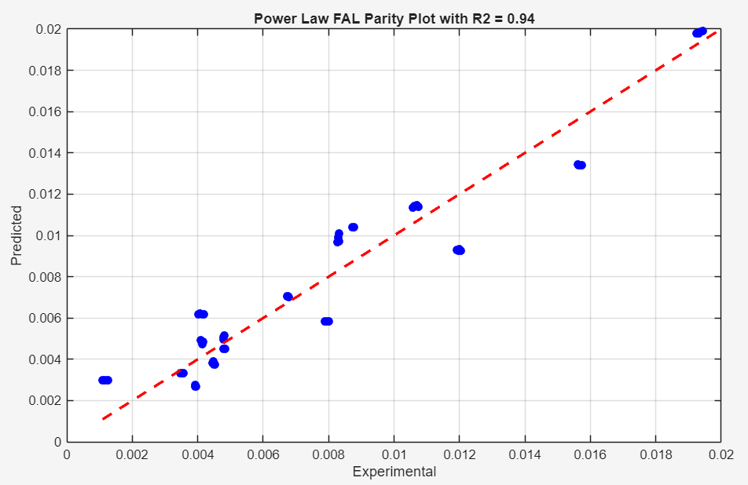
Parity Plot - FAL to 2-MF

Slide 12
LHHW Model Overview
Why go beyond Power Law?
Power law models provide good statistical fit but limited mechanistic insight
Cannot explain:
Competitive adsorption
Surface reaction mechanism
Product inhibition
Effect of site coverage
LHHW provides a mechanistic, surface-kinetics-based framework.
Used when:
Rate-controlling step is surface reaction
Reactants adsorb on active sites
Surface coverage influences rate

Slide 13
LHHW Model
Key Assumptions of LHHW :
All reactants, intermediates, and products adsorb on the same type of catalyst active site (for Single Site).
Hydrogen adsorb on the hydrogen active catalyst sites whereas others adsorb on the other organic catalyst active sites (for Dual Site).
Molecular adsorption of Furfural, Furfuryl alcohol and 2-Methyl Furfuran.
Hydrogen adsorbs dissociatively.
Surface-reactions step are rate-controlling.
Catalyst does not deactivate during experiments.
Ideal-gas behaviour.
We have total of 2 Models (2 rate equations each)

Slide 14
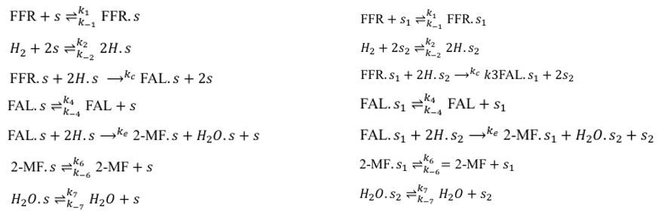
Elementary Reactions
Single Site RM Dual Site RM
RDS are reaction 3 and reaction 5

Slide 15
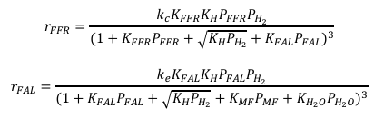
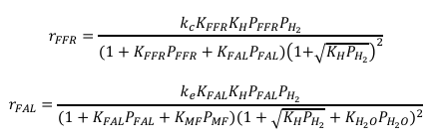

LHHW Model
LH-I RM LH-II RM
Arrhenius Equation:
$$k_{i}=k_{ref_{i}}\exp\left[−\frac{E_{i}}{R}\left(\frac{1}{T}−\frac{1}{T_{r}}\right)\right]$$
Van’t Hoff Adsorption Equation:
$$K_{i}^{ads}=\exp\left[\frac{△S_{i}^{ads}}{R}−\frac{△H_{i}^{ads}}{R} \left(\frac{1}{T}−\frac{1}{T_{r}}\right)\right]$$
Total parameters estimated: 9 per model (2 $k_{ref_{i}}$, 2 $E_{i}$ and 5 $△S_{i}^{ads}$).

Slide 16
KINETICS RESULT
Reaction Mechanism and Model | Rate Constant | k_ref (mol/h g-cat) | (-95%) CI | (+95%) CI | Ei (KJ mol) | -95% CI | +95% CI | RMSE | F-Test Statistics
LH-I | kc | 0.12215 | 0.04097 | 0.20333 | 34.31 | 15.42 | 53.20 | 0.003035 | (F=123.09), (p=0.0000)
Single Site | ke | 71.02 | 26.39 | 115.65 | 37.02 | 12.84 | 61.20 | 0.000542 | (F=123.09), (p=0.0000)
LH-II | kc | 0.02253 | 0.02035 | 0.02471 | 37.73 | 29.88 | 45.58 | 0.003756 | (F=74.08), (p=0.0000)
Dual-Site | ke | 123.72 | 74.12 | 173.32 | 60.13 | 29.80 | 90.46 | 0.000583 | (F=74.08), (p=0.0000)

Slide 17
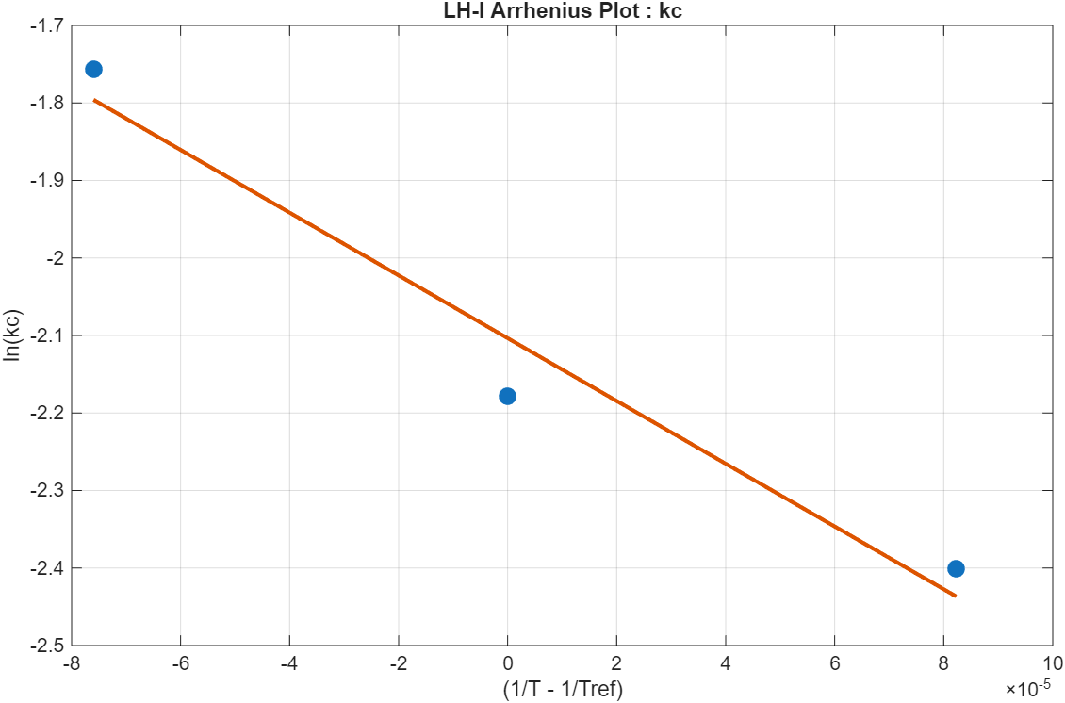
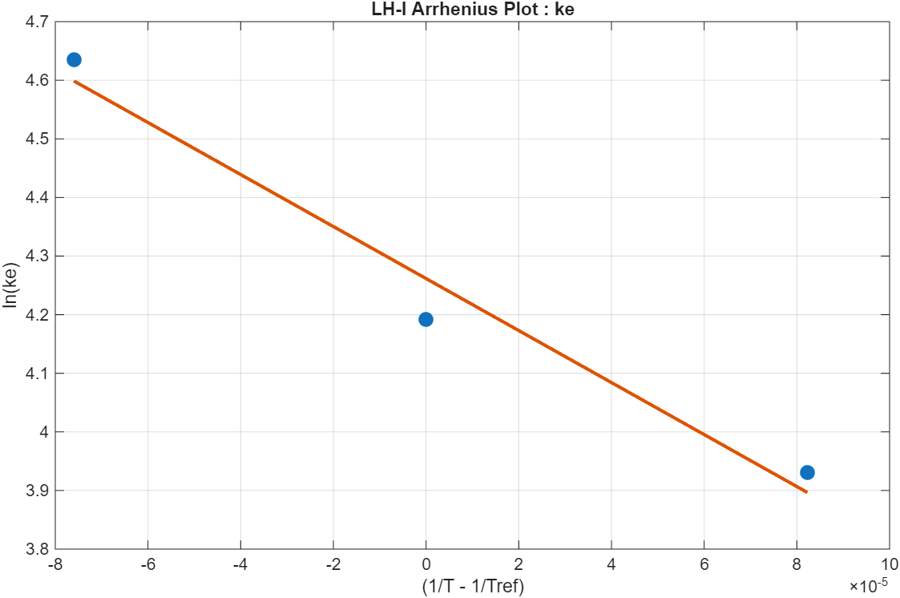


ARRHENIUS ANALYSIS LH-I
Slope = -E/R = -4048.4
Intercept = ${lnk}_{c_{ref}}$= -2.1035
Slope = -E/R = -4436.7
Intercept = ${lnk}_{e_{ref}}$= 4.2616

Slide 18
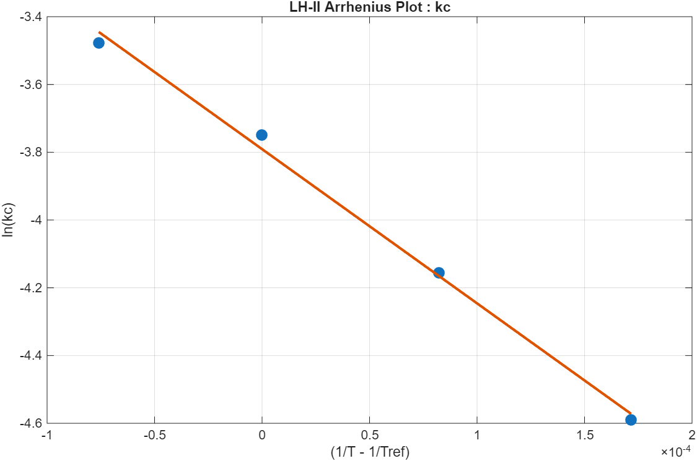
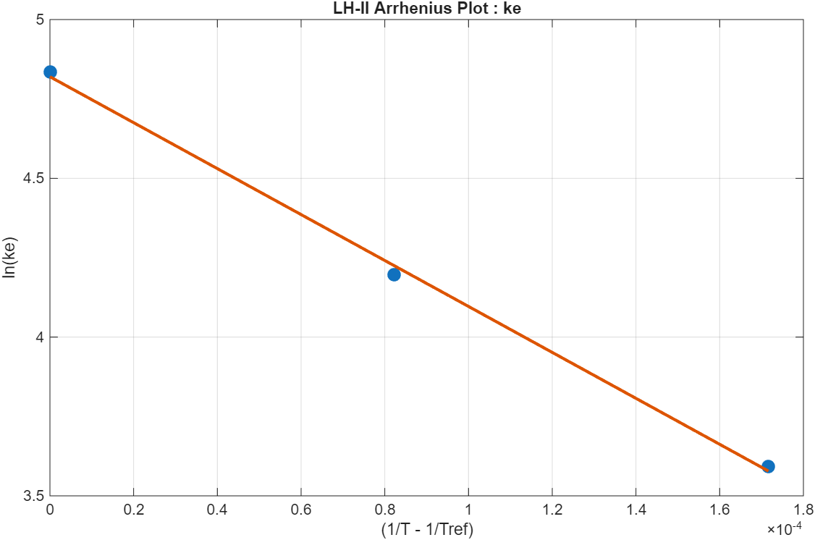


ARRHENIUS ANALYSIS LH-II
Slope = -E/R = -4551.3536
Intercept = ${lnk}_{c_{ref}}$= -3.79086
Slope = -E/R = -7234.96573
Intercept = ${lnk}_{e_{ref}}$= 4.81989

Slide 19
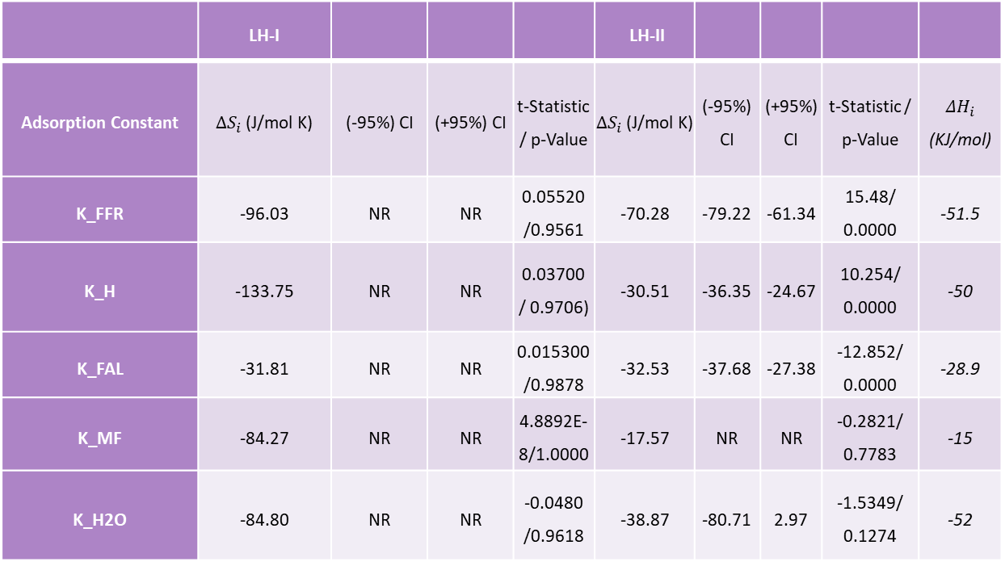

THERMODYNAMICS RESULTS
 | LH-I |  |  |  | LH-II
Adsorption Constant | $ΔS_{i}$ (J/mol K) | (-95%) CI | (+95%) CI | t-Statistic / p-Value | $ΔS_{i}$ (J/mol K) | (-95%) CI | (+95%) CI | t-Statistic / p-Value | $ΔH_{i}$ (KJ/mol)
K_FFR | -96.03 | NR | NR | 0.05520 /0.9561 | -70.28 | -79.22 | -61.34 | 15.48/ 0.0000 | -51.5
K_H | -133.75 | NR | NR | 0.03700 / 0.9706) | -30.51 | -36.35 | -24.67 | 10.254/ 0.0000 | -50
K_FAL | -31.81 | NR | NR | 0.015300 /0.9878 | -32.53 | -37.68 | -27.38 | -12.852/ 0.0000 | -28.9
K_MF | -84.27 | NR | NR | 4.8892E-8/1.0000 | -17.57 | NR | NR | -0.2821/ 0.7783 | -15
K_H2O | -84.80 | NR | NR | -0.0480 /0.9618 | -38.87 | -80.71 | 2.97 | -1.5349/ 0.1274 | -52
CHANGE IN ENTROPY OF ADSORPTION ($△S_{i}^{ads}$)

Slide 20
CORRELATION
LH-I | dS1 | dS2 | dS4 | dS6 | dS7
dS_FFR | 1.000 | 1.000 | 1.000 | -0.042 | -1.000
dS_H | 1.000 | 1.000 | 1.000 | -0.042 | -1.000
dS_FAL | 1.000 | 1.000 | 1.000 | -0.042 | -1.000
dS_MF | -0.042 | -0.042 | -0.042 | 1.000 | 0.042
dS_H2O | -1.000 | -1.000 | -1.000 | 0.042 | 1.000
LH-II | dS1 | dS2 | dS4 | dS6 | dS7
dS1 | 1.000 | -0.518 | 0.036 | -0.032 | 0.067
dS2 | -0.518 | 1.000 | -0.169 | -0.006 | -0.051
dS4 | 0.036 | -0.169 | 1.000 | 0.664 | -0.756
dS6 | -0.032 | -0.006 | 0.664 | 1.000 | -0.977
dS7 | 0.067 | -0.051 | -0.756 | -0.977 | 1.000

Slide 21
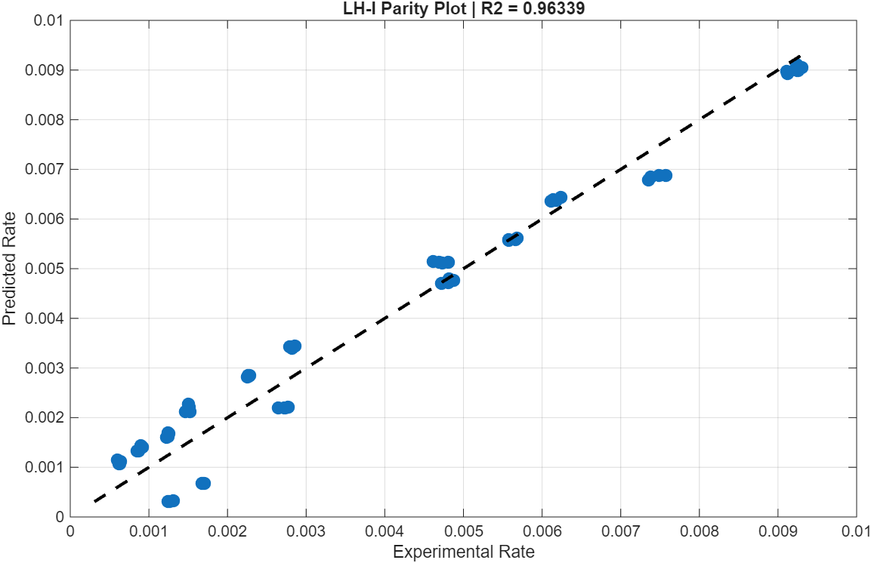
PARITY PLOT LH-I

Slide 22
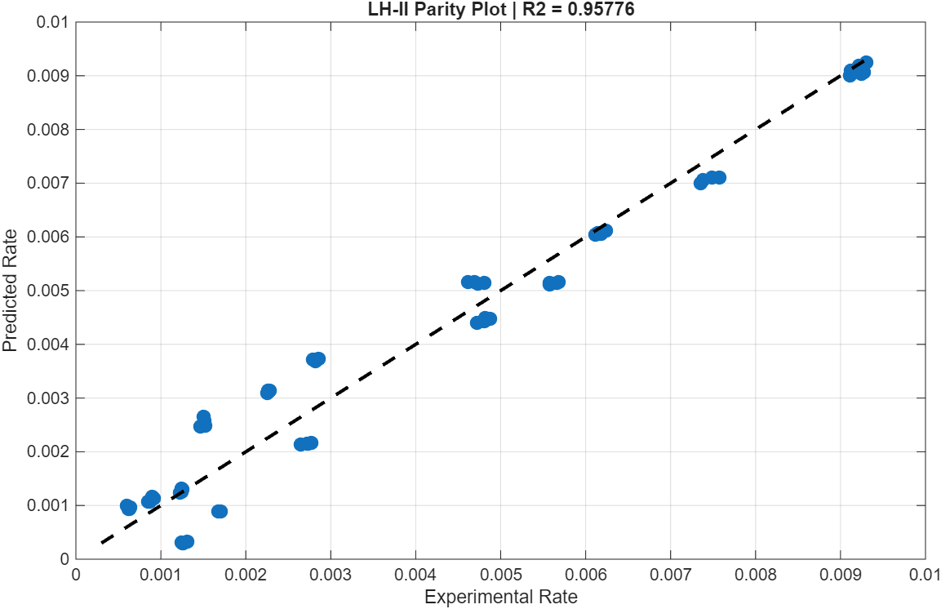
Parity Plot LH-II

Slide 23
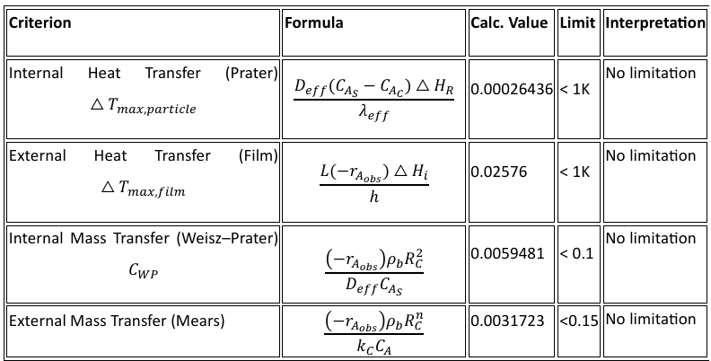
HEAT AND MASS TRANSFER LIMITATION

Slide 24
FINDINGS
Reaction Step | Present Work (LH-II) | Literature Trend | Interpretation
Furfural → FAL (Hydrogenation) | 37.73 kJ/mol | Lower Ea reported for carbonyl hydrogenation | Kinetically easier step
FAL → 2-MF (Hydrodeoxygenation) | 60.13 kJ/mol | Higher Ea reported for HDO reactions | Rate controlling / energy demanding step
Consistent with Previous Studies
Cu-based catalysts favor sequential:
FFR → FAL → 2-MF
Furfuryl alcohol identified as major intermediate.
Thermodynamic Consistency
Adsorption Parameters Negative ΔS → Reduced randomness during adsorption
Physically meaningful adsorption behavior obtained

Slide 25
CONCLUSION
Developed kinetic models for furfural hydrodeoxygenation using: Power Law model and Langmuir–Hinshelwood (LH) model.
Dual-site LHHW model (LH-II) showed: Better thermodynamic consistency, lower parameter correlation and improved statistical reliability.
Activation energy results indicated:
Furfural hydrogenation is kinetically easier
Deoxyhydrogenation (FAL → 2-MF) is the more energy-demanding step
Negative ΔS values confirmed: Exothermic adsorption and Reduced randomness during adsorption.
Heat and mass transfer analyses confirmed:
Absence of transport limitations
Observed rates represent intrinsic kinetics
Developed model successfully explained:
Adsorption effects
Surface reaction mechanism
Selective formation of 2-Methylfuran (2-MF)

Slide 26
References
https://www.sciencedirect.com/science/article/pii/S0016236122035359
https://www.sciencedirect.com/science/article/pii/S0016236124002485
https://www.sciencedirect.com/science/article/pii/S2213343716303736
https://pubs.acs.org/doi/full/10.1021/ acs.iecr.5b03828
H. Scott Fogler. Elements of Chemical Reaction Engineering. 5th Edition.

